Slide 1
Play store analysis
CAPSTONE PROJECT
Presented By:
K.SARAVANAKUMAR
SHANMUGANATHAN ENGINEERING COLLEGE
ELECTRICAL AND ELECTRONICS ENGINEERING

Slide 2
OUTLINE
Problem Statement
Proposed System/Solution
System Development Approach
Algorithm & Deployment
Result
Conclusion
Future Scope
References

Slide 3
Problem Statement
In this project I am going to analyze PlayStore dataset
Analyze user ratings, reviews, and download metrics to identify factors influencing app success or failure.
Explore correlations between app features, such as size, price, or category, and user engagement metrics like ratings and retention rates.
Predict future download trends for specific app categories to inform marketing and development strategies.

Slide 4
Proposed Solution
Conduct EDA to understand the distribution and characteristics of the data.
Identify correlations between different metrics and potential patterns or trends.
Establish a framework for continuous monitoring of app performance metrics and market trends.
Implement iterative improvements based on data-driven insights to enhance app performance and user satisfaction over time.

Slide 5
System Approach
System Requirements:
Hardware:
A computer with sufficient processing power, preferably with multiple cores or a GPU for faster training of machine learning models.
Adequate RAM to handle the size of the dataset and computational requirements.
2. Software:
An operating system compatible with the required machine learning libraries (e.g., Windows, Linux, macOS)
3. Library requirements:
Pandas
NumPy
Matplotlib
Seaborn

Slide 6
Algorithm & Deployment
Algorithm selection:
Data Collection: Utilize Google Play Store APIs or web scraping techniques to gather relevant data,
including app metadata, user reviews, ratings, and download statistics.
Data Preprocessing:
Cleanse the collected data by removing duplicates, outliers, and irrelevant information.
Normalize and standardize data formats for consistency.
Handle missing data through imputation or removal based on the context.
Exploratory Data Analysis (EDA):
Perform EDA to understand the distribution, patterns, and relationships within the data.
Visualize key metrics such as app ratings, downloads, and revenue across different categories.
Identify trends, outliers, and potential areas for further analysis.

Slide 7
Algorithm & Deployment
Data input:
Feature Engineering:
Extract relevant features from the data that could be used for analysis and modeling.
Generate new features or transformations that might capture additional insights.
Modeling and Analysis:
Choose appropriate statistical or machine learning models based on the nature of the analysis tasks (e.g., regression, classification, clustering).
Train models to predict app performance metrics, user behavior patterns, or market trends.
Evaluate model performance using appropriate metrics and validation techniques.
Interpretation and Insights:
Interpret model results to derive actionable insights and recommendations.
Identify key factors influencing app success, user engagement, and revenue generation.
Communicate findings effectively to stakeholders through reports, dashboards, or presentations.

Slide 8
Algorithm & Deployment
Training process:
Infrastructure Setup:
Choose a scalable infrastructure for hosting your analysis platform, considering factors such as data volume, processing requirements, and budget constraints.
Options include cloud-based solutions like AWS, Google Cloud Platform, or Azure, or on-premises infrastructure.
Containerization:
Containerize your analysis code and dependencies using Docker for easy deployment and reproducibility.
Docker containers ensure consistency across different environments and simplify deployment across various platforms.
Orchestration:
Utilize container orchestration platforms like Kubernetes to manage and deploy your Docker containers at scale.
Kubernetes provides features for automatic scaling, load balancing, and fault tolerance, ensuring high availability and reliability of your analysis platform.

Slide 9
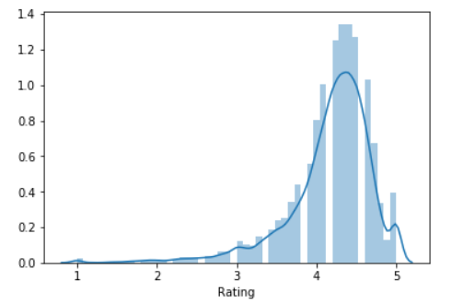
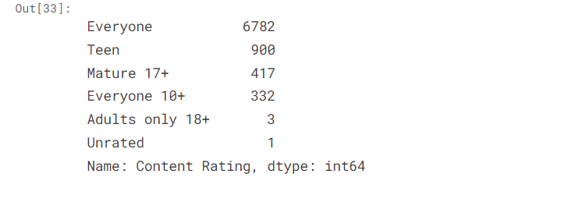
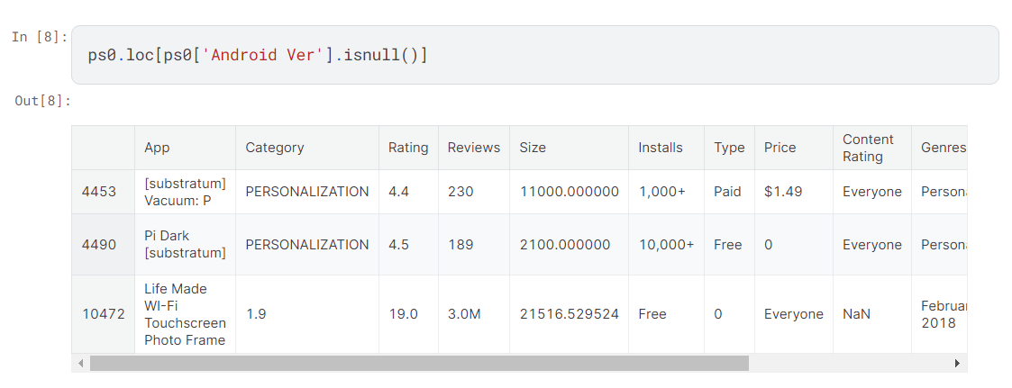
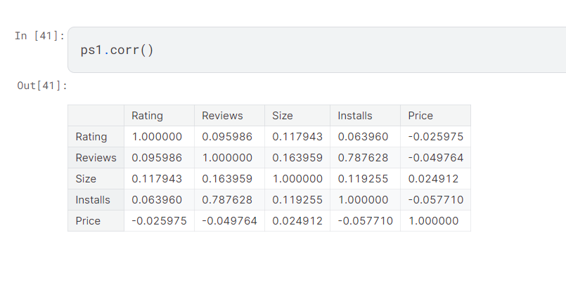
Result

Slide 10
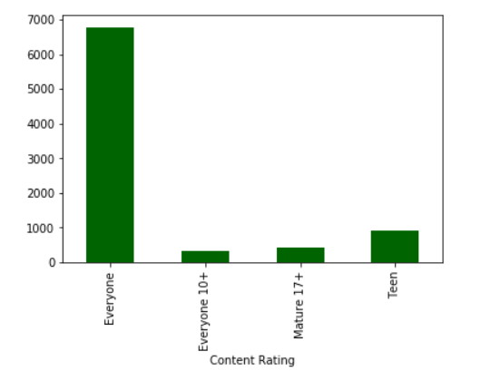
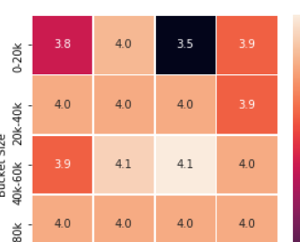
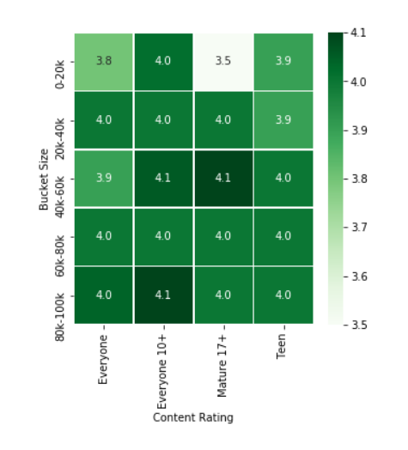
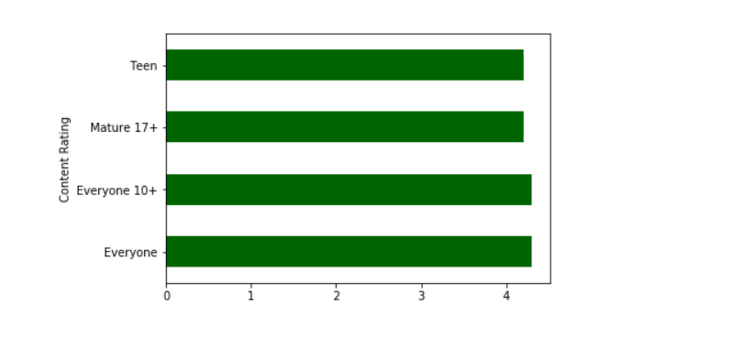
Result

Slide 11
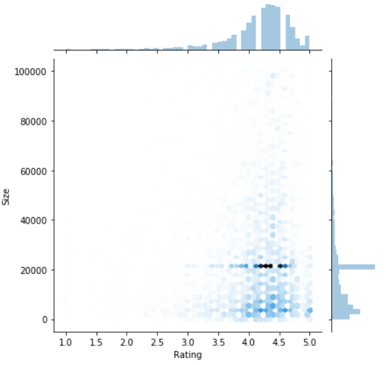
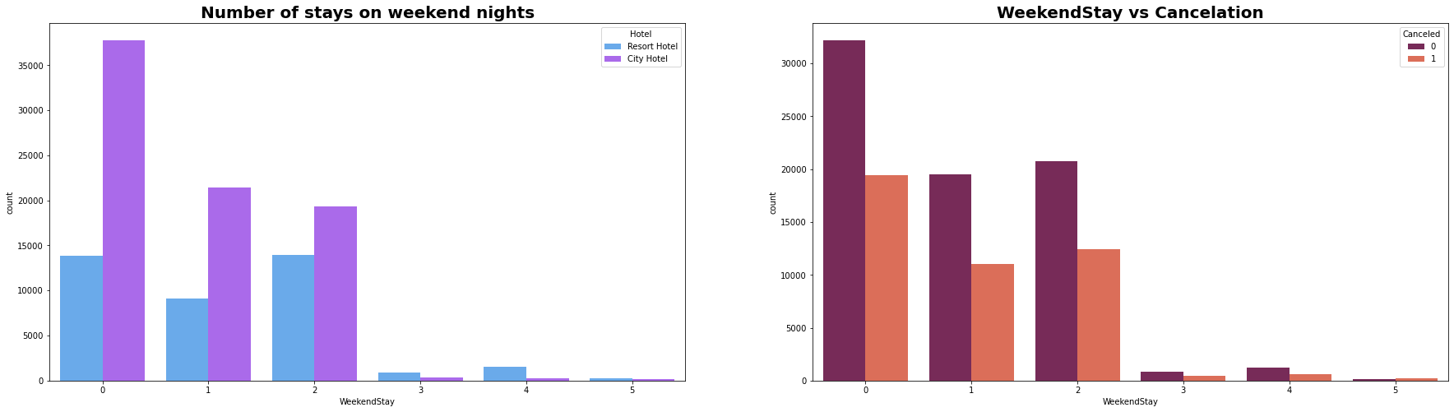
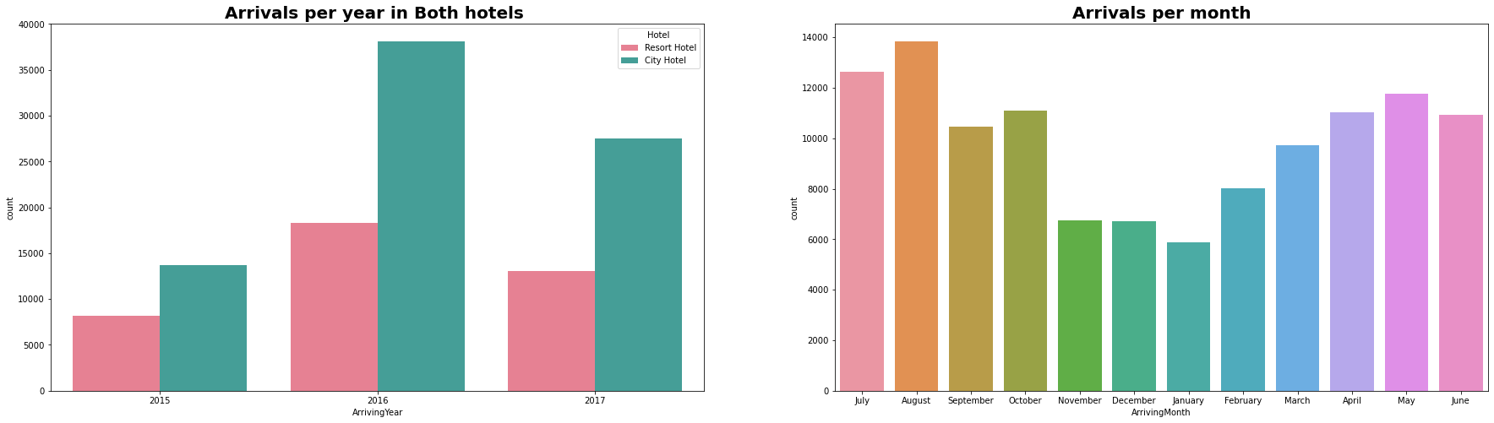
Result

Slide 12
Conclusion
Conducting analysis of the Google Play Store ecosystem provides valuable insights that can inform strategic decision-making for app developers, marketers, and stakeholders. Through a comprehensive approach that includes data collection, preprocessing, exploratory analysis, modeling, and deployment, we can derive actionable insights to optimize app performance, drive user engagement, and maximize revenue generation.

Slide 13
Future scope
Here are key areas for future exploration and enhancement
Deep Learning for Sentiment Analysis: Leveraging deep learning techniques such as recurrent neural networks (RNNs) and transformers for more accurate sentiment analysis of user reviews. This can provide deeper insights into user preferences, satisfaction levels, and areas for improvement.
Personalized Recommendations: Utilizing machine learning algorithms to develop more personalized app recommendations based on user behavior, preferences, and contextual factors. This can enhance user engagement and drive app discovery in a crowded marketplace.

Slide 14
References
https://www.Kaggle.com/datasets
https://seaborn.pydata.org/
https://matplotlib.org/stable/contents.html
https://pandas.pydata.org/pandas-docs/stable/user_guide/index.html

Slide 15
THANK YOU

